Slide 1
Customer Segmentation Based on Purchasing Behavior
Presented By:
Vema Eekshita Naga Venkata Lakshmi Sai
Department of Data Science
Acharya Nagarjuna University College of Engineering & Technology

Slide 2
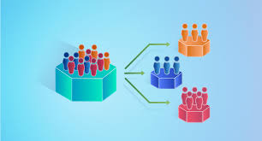
PROJECT OBJECTIVES
Segment customers based on purchasing behavior using RFM (Recency, Frequency, Monetary) analysis.
Identify customer groups such as high-value, medium-value, and low-value segments.
Enhance marketing strategies by targeting each customer group more effectively.
Increase business revenue by understanding and acting on customer behavior insights.

Slide 3
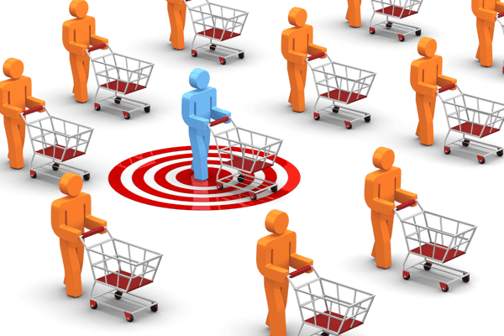
INTRODUCTION
Customer segmentation helps businesses understand buying behavior.
Enables personalized marketing and better customer engagement.
This project uses RFM (Recency, Frequency, Monetary) analysis to group customers based on purchasing patterns.
Goal: Identify high-value customers and improve business strategies through data-driven insights.

Slide 4
PROBLEM STATEMENT
Retail businesses often struggle to understand and categorize their customers due to the diversity in purchasing behavior.
Without proper segmentation, marketing efforts become generalized, leading to poor customer engagement and revenue loss.
This project aims to address this gap by analyzing customer purchase patterns to create meaningful customer segments that help in targeted marketing and improved customer satisfaction.

Slide 5
DATASET DESCRIPTION
Total Records: 5000 rows
Total Features: 21
Data Type: Tabular retail transactional data
Source: Kaggle
Customer & Demographics:
Customer_ID: Unique identifier
Age, Gender, Income: Demographic features
Location: Geographical location
Behavioral Data:
Loyalty_Points_Used
Previous_Purchases
Average_Spending
Last_Purchase_Days_Ago
Browsing_Time_Before_Purchase
Preferred_Shopping_Time
Customer_Satisfaction_Rating
Transaction Details:
Transaction_ID, Date: Purchase transaction info
Product_Category, Product_ID: Product type and ID
Quantity, Unit_Price: Purchase details
Total_Spent: Calculated from Quantity Price
Discount_Applied, Payment_Method

Slide 6
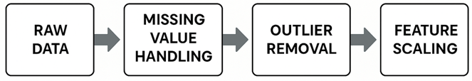
DATA PREPROCESSING
MISSING VALUE HANDLING
Age 4997 float64
Gender 4995 object(Male, Female, Other)
Income 4996 float64
Location 4996 object (City, suburb, Rural)
Customer_Segment 4997 object (Low, Medium, High)

Slide 7
FEATURE ENGINEERING
CREATING RFM FEATURES
Creating the Recency, Frequency, Monetary features by using these columns 'Customer_ID', 'Last_Purchase_Days_Ago', 'Previous_Purchases', 'Average_Spending'

Slide 8
EXPLORATORY DATA ANALYSIS
In this step, the analysis can be done as univariate analysis, bi variate analysis and multi variate analysis.
UNIVARIATE ANALYSIS
Age
Gender
Location
Product_Category
BI VARIATE ANALYSIS
Age by Total_Spending
Total_Spending by Gender
Spending and Preferred shopping time

Slide 9
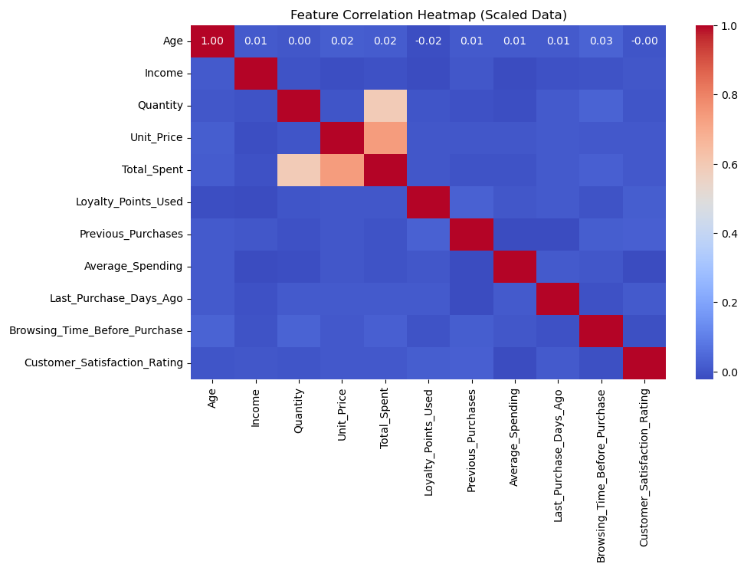
MULTI VARIATE ANALYSIS

Slide 10
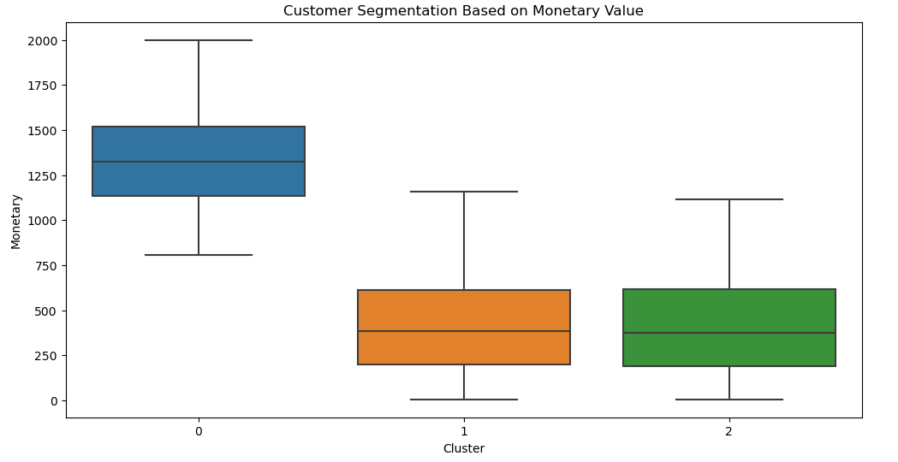
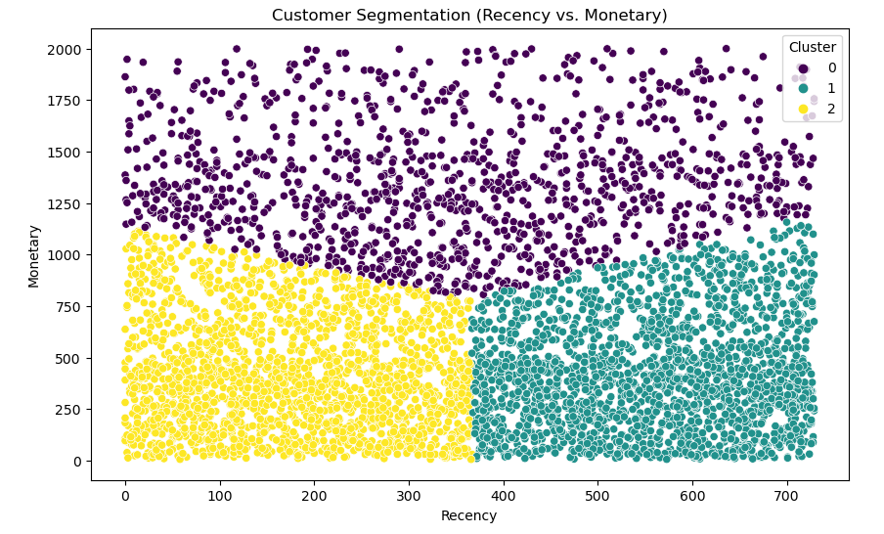
RFM ANALYSIS

Slide 11
CLUSTERING TECHNIQUES AND ANALYSIS
K-MEANS : K-Means is an unsupervised clustering algorithm that groups data into K distinct clusters based on feature similarity. It minimizes the variance within each cluster by iteratively updating centroids until convergence. It's efficient, simple, and widely used in segmentation tasks.
AGGLOMORATIVE : Agglomerative clustering is a hierarchical algorithm that starts with each point as its own cluster and merges the closest pairs iteratively. It builds a dendrogram to visualize the merging process and is useful for exploring nested cluster structures.
DBSCAN (Density-Based Spatial Clustering of Applications with Noise): DBSCAN clusters data based on density, identifying core points, reachable points, and outliers. It doesn't require specifying the number of clusters and can find arbitrarily shaped clusters, making it effective for noisy and complex datasets.

Slide 12
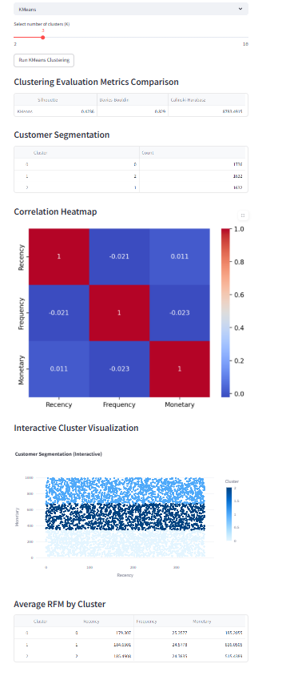
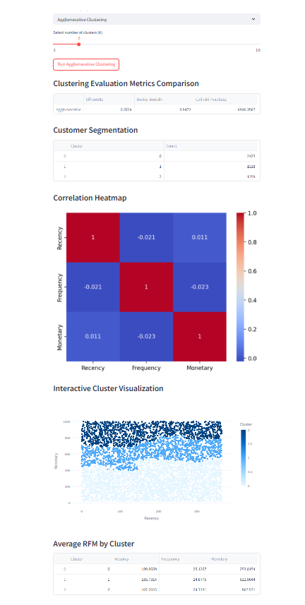
OUTCOMES
K-MEANS CLUSTERING
AGGLOMORATIVE

Slide 13
THANK YOU

